Slide 1
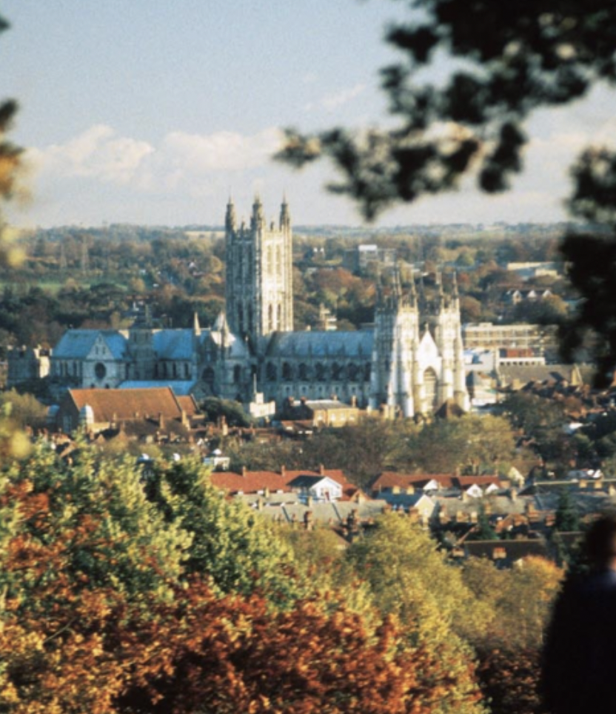
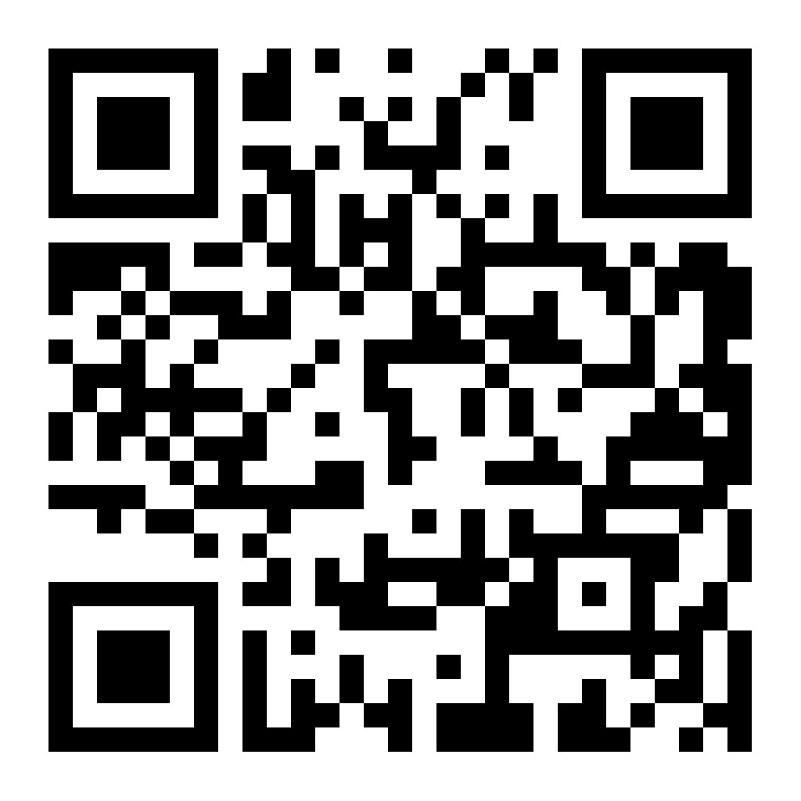
Kent Econometrics Workshop 2025
Friday, 30th of May 2025, Venue: SIBSR1
The Kent Econometrics Workshop, 2025 will be held at Canterbury campus, University of Kent on Friday 30th of May 2025 from 10:30-17:30. The workshop will focus on Recent Advances In Spatial/Panel Data econometrics (theory and applications). We gratefully acknowledge funding from The British Academy and the Leverhulme trust.
If you would like to attend, please contact Dr. Maria Kyriacou (email: m.kyriacou@kent.ac.uk)
Scientific/Organizing Committee:
Maria Kyriacou (University of Kent)
Rowan Cherodian (University of Sheffield)
Scan the QR code below or visit https://mariakyriacou.net/kent-econometrics-workshop-2025-3/ to access the program and more information.

